Slide 1

Product Marketing
https://www.mentorengageb2b.com/
Notes:
Logo description:
Khurshid

Slide 2
Table of Content / Agenda
Brand Positioning - Introduction
ROI
Buyer’s Persona
Brand Positioning
Content
Buyer's Journey
Competitive Analysis
$
Channels
Pricing & Budget
Perceptual Map
SEO

Slide 3


Mentor Engage B2B
Notes:
Elevator Pitch – Story about Mentorengage B2B
Transcript
Good Morning everyone
Explain Mentor ENgeB2B
Tell A personal tor of not having a mentor when joined a company
What value add Mentoring software brings
What our product is solving- Elements of Vlaue
Khurshid

Slide 4
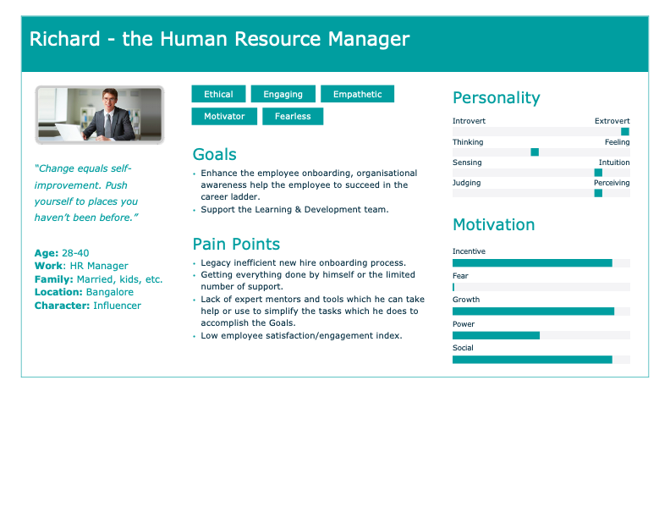
Notes:
Khurshid

Slide 5
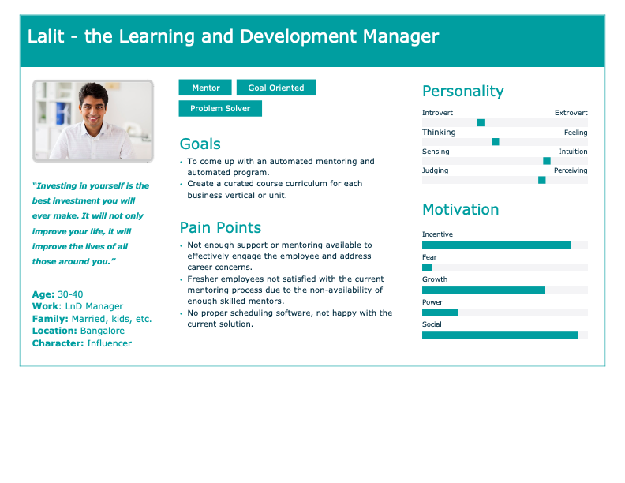
Notes:
Khurshid

Slide 6
Buyer's Journey Marketing Funnel
Awareness
SEO, Blogs, Billboards, Google Ads, Social Media Posts, Flyers
Interest
Landing Page, Explainer Video, Direct EMail, Newsletters, Sign-in, Webinars, Virtual Events, Pricing, Demonstration, Trials
Consideration
Engagement
Evaluation
Subscriptions
Purchase
Notes:
Khurshid

Slide 7






Channels
BillBoard
LinkedIn
Google Ads
Email campaigns
Online Webinar
HR Portal
Notes:
Aju

Slide 8
Brand Positioning Statement
Target Customer
Market Definition
Brand Promise
Reasons to Believe
Executives who are passionate and responsible for employee engagement, development and leadership
Employee engagement and mentoring solutions in B2B category for medium and Large businesses
Increase in business performance, teamwork,
Peer relationships,
job satisfaction
Our customer base and testimonials
Notes:
Aju

Slide 9
Positioning Message
For HR and L&D Managers of medium and large businesses
Who need to enhance employee skill and engagement. MentorEngage(B2B) is a platform that allows to upskill, manage and measure employee engagements that provide real-time actionable insights Unlike manual procedures and solutions like Chronus, MentorCity etc.
MentorEngage(B2B) brings out the best in your employees and keeps them engaged during the process by offering the best
learning experiences from the industry best of mentors and business experts.
Notes:
Aju

Slide 10
Positioning Message
140 Characters (~25 Words) Mentorengage(B2B) is a digital mentoring platform that assists businesses to realise the full potential of their employees.
280 Characters (~50 Words) MentorEngage(B2B), a platform that assists organisations with its visionary digital mentoring solution. Some of the main services include mentor- mentee collaboration, coaching by subject matter experts and industrial specialists, online curated coaching content, AI based program and mentor matching, lucid visualisation and planning.
500 Characters (~100 Words) For HR and L&D Managers of Medium and Large Businesses who need to Enhance employee Skill and engagement. MentorEngage(B2B) is a platform that allows to upskill, manage and measure employee engagements that provide real-time actionable insights Unlike manual procedures and solutions like Chronus, MentorCity etc.
MentorEngage(B2B) brings out the best in your employees and keeps them engaged during the process by offering the best learning experiences from the best of mentors and business experts.
Notes:
Aju

Slide 11
Messaging Pillars
Value For Money | Ease of Use | Stellar Customer Service
Feature Rich | Intuitive User Interface | 24/7 Customer Support
Flexible Pricing Model | Access Anywhere | Chat Bot
Company Brand and Affiliation | Seamless Integration | Intuitive Manuals Video Tutorial
Supporting Messages
Notes:
Aju

Slide 12
Value Proposition
Employee engagement and employee mentoring are serious affairs and that is why we have created MentorEngage(B2B).
With MentorEngage(B2B) there would be less attrition, a better employee satisfaction index, increased promotion rates and no missed training or repeated follow-ups. The platform has many useful tools that are intuitive and easy to use. AI-based Tools that schedule, track, recommend and report out for the best experience and satisfaction. We also have a certificate program for L&D managers curated by 50 top-notch industrial experts, which is completely free.
Notes:
Aju

Slide 13






Product Positioning: Perceptual Map
High
Mentor Engage B2B
Engagedly
Push Far
Chronus
Mentorloop
Capabilities
Mentornity
Low
Engagement
High
Notes:
Capabilities: No of feature is high...
Engagement: Powerful interactive tools and easy to understand content which educates, entertains and engages the user from an emotional connection
Aju

Slide 14


Competitive Analysis
Company & Product
Professionals and Students who want to become mentors and companies who want mentorship programs | Medium and Large companies who want mentorship programs | Medium and Large companies who want mentorship and engagement programs
mentorship on a vast range of subjects | mentorship targeting remote and diverse workforce | mentorship and engagement pertaining to maximise potential, develop skills, improve performance and to become the person one wants to be
User Based Pricing model | User Based Pricing model | User Based Pricing model
PushFar's mentoring platform is open to everyone from students through to professionals and those recently retired professionals. We thrive on helping everyone to share their knowledge and experience, mentoring each other. | Impactful mentoring programs to develop people and deliver results | Digital mentoring platform which help businesses to unleash their full potential
Target Customers
Key Benefits
Price
Value Proposition
Notes:
AjuAju/khurshid

Slide 15
Market Sizing (Bottom Up)
6.1 Cr
36.6 Cr
2496 Cr
Service Obtainable Market
(SOM)
Serviceable Available Market
(SAM)
Total Available Market
(TAM)
Notes:
Asit
SOM is calculated based on our Revenue on Premium model
SAM = 6.1* 6 major cities of India
TAM = 8000000*260*12 =24,96,00,00,000
https://www.process.st/tam-sam-som/#calculate

Slide 16
Marketing Budget
1.09
10.69
Product Marketing
Website Redesign
61
2.09
15.9
Content Marketing
Overall Marketing Budget
Events
25.6
3.6
1.3
Paid Advertising
Branding Creative
Public Relations
# All amount in lakhs
Notes:
Asit

Slide 17
Pricing
120/month
200/month
260/month
0/14 days
Basic
Professional
Premium
Freemium
A Perfect plan for a good start
A good plan for the advanced
A perfect plan for the Experts
Try all the features
Action Item Tracking
Appointment Scheduling,
Goal Setting
Action Item Tracking
Appointment Scheduling
Curriculum Manage
All Features
All Premium Features
Notes:
Aju/Khurshid

Slide 18

Pricing Model
Features | Basic | Professional | Premium
Mentor Matching
Mentor Management
Reporting
REAL-TIME FEEDBACK
Customer Support
Platform Support
Training Support
ONLINE LEARNING
D&I - ERG Programs
Advance Analytics
Industry Insigts
Multilingual Support
New Hier Onboarding
Career Progression
High Potential & Leadership Development Programs
Breakdown Silos between Departments & Locations
Notes:
Asit
Pricing my proposals
1. Free License for POC period - 90 Days ( Advanced) - All Values will be in Freemium
2. Pay As you Go
3. Fixed Runrate for 1 year, 2 Year & 3 Year.
Clauses
1.Feature adoption roll out will be CI/CD mode
2. Fixed runrate can not be converted to pay as you go once they are in fixed run rate
3. Pay As you go can be converted to fixed run rate any time
Features
Action Item Tracking
Appointment Scheduling
Curriculum Management
Goal Management
Mentor/Coach Matching
Mentoring Program Management
Progress Tracking
24/7 Support
9-5PM Support
API Support for integration

Slide 19








Multifold Return on Investment (ROI)
Business Performance
Reduced Conflict
Teamwork
Reduced Attrition
Peer Relationship
Missed Trainings
Job Satisfaction
Repeat Reminders
Notes:
Asit
Improved Business performance as a result of establishing stronger internal mentoring platform using mentor engage b2b
Improved teamwork
Improved relationship with peers
Improved job satisfaction
Reduced conflicts
Reduced attrition
No missed trainings
No repeated reminders

Slide 20

SEO Strategy to Increase Online Visibility
1. Keyword Research
2. Competitor Research
Researched most popular and high ranking keywords and added them as positioning, taglin, Landing page for better probability of showing up in google search.
Analyzed and researched PushFars’s and Chronus’s Domain Authority, backlinks, referring domains and Organic monthly
3. Content Strategy
4. Link Build Campaign
L&D certificate page: This page has to self sufficient to entice the target audience for the free and valuable Certification to become L&D managers with superpower insightful Blogging linking the main page
Guest Blogging paid support from HR.com. HR.com works as our influencer. Virtual Webinars on ROI of Employee mentoring and Employee engagement.
‹#›
Notes:
Khurshid

Slide 21
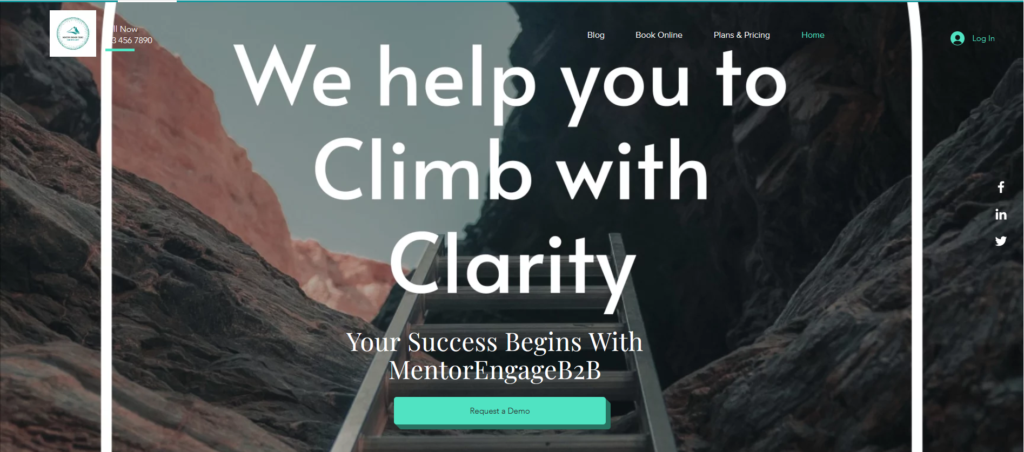
Landing Page
Notes:
Khurshid/Aju

Slide 22

Explainer Video
Notes:
Khurshid

Slide 23


Bill Board One
A push in the right direction...
#MentorEngageB2B
Notes:
Khurshid

Slide 24
Bill Board Two
Climb with Clarity...
#MentorEngageB2B
Notes:
Khusrshid/Asit

Slide 25

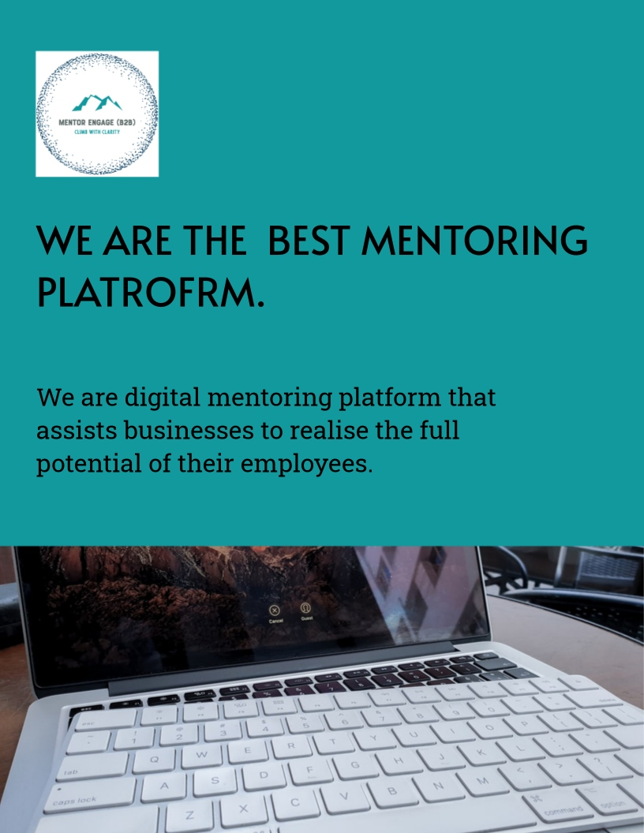
Flyers
Notes:
Khurshid/Asit

Slide 26


Posters
Notes:
Khurshid/Asit

Slide 27

Thank you!
https://www.mentorengageb2b.com/
Notes:
Logo description:

Slide 28

Questions?
Notes:
Logo description:

Slide 29
Appendix
Notes:
Logo description:

Slide 30
Email Campaigns
How are you Richard?
I noticed you recently visited the MentorEngage(B2B) product page; I'm glad you're interested!
I wanted to reach out and see if there was anything I could answer for you.
I'd love to give you a personal tour of MentorEngage(B2B) and show you how similar businesses are currently utilising the platform.
Kindly schedule a time to speak 1:1 at a time that is convenient for you.
If you're not quite ready to request a demo but would like to learn more about how MentorEngage(B2B) can help your business scale, check out this case study about how Suraksha Fit increased employee mentor engagement by 78% using MentorEngage (B2B)
I appreciate your time and look forward to speaking with you again soon.
The best,

Slide 31
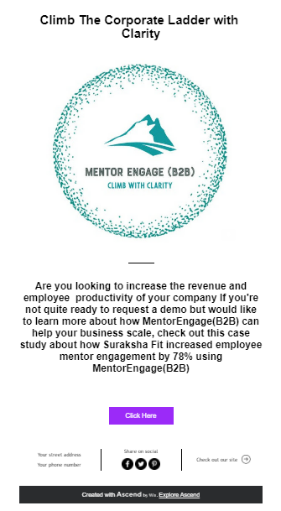
Email in the recipient inbox

Slide 32
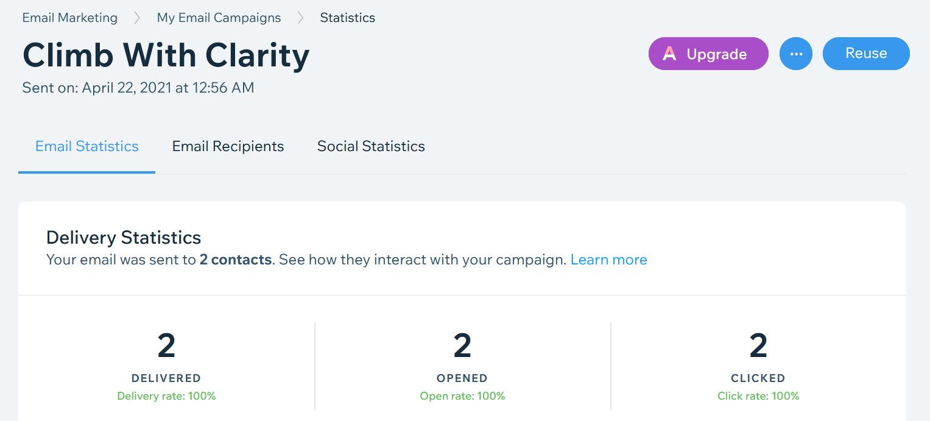
Email Campaign

Slide 33
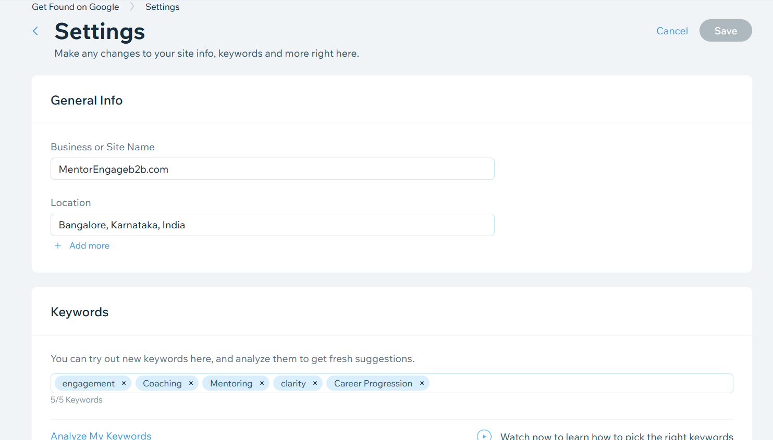
SEO for Google

Slide 34
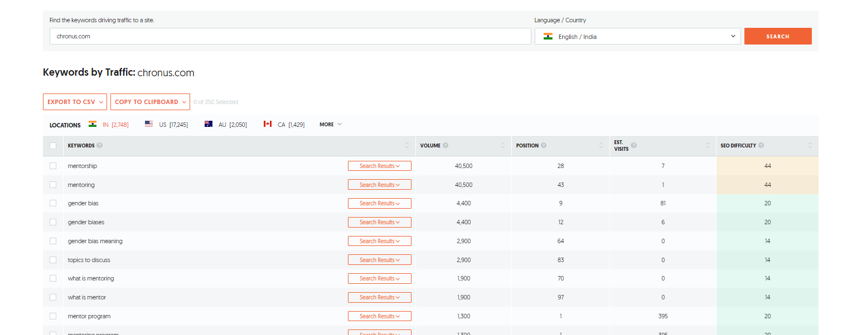
SEO for competitive analysis

Slide 35
Pricing
 | Standard | Professional | Premium
Per User /Month | INR 120 | INR 200 | INR 250
Fixed Run Rate 1 Year | INR 50 | INR 125 | INR 175
Fixed Run Rate 2 year | INR 35 | INR 80 | INR 100
Fixed Run rate 3 Year | INR 25 | INR 60 | INR 70
Notes:
Pricing my proposals
1. Free License for POC period - 90 Days ( Advanced) - All Values will be in Freemium
2. Pay As you Go
3. Fixed Runrate for 1 year, 2 Year & 3 Year.
Clauses
1.Feature adoption roll out will be CI/CD mode
2. Fixed runrate can not be converted to pay as you go once they are in fixed run rate
3. Pay As you go can be converted to fixed run rate any time
Features
Action Item Tracking
Appointment Scheduling
Curriculum Management
Goal Management
Mentor/Coach Matching
Mentoring Program Management
Progress Tracking
24/7 Support
9-5PM Support
API Support for integration

Slide 36
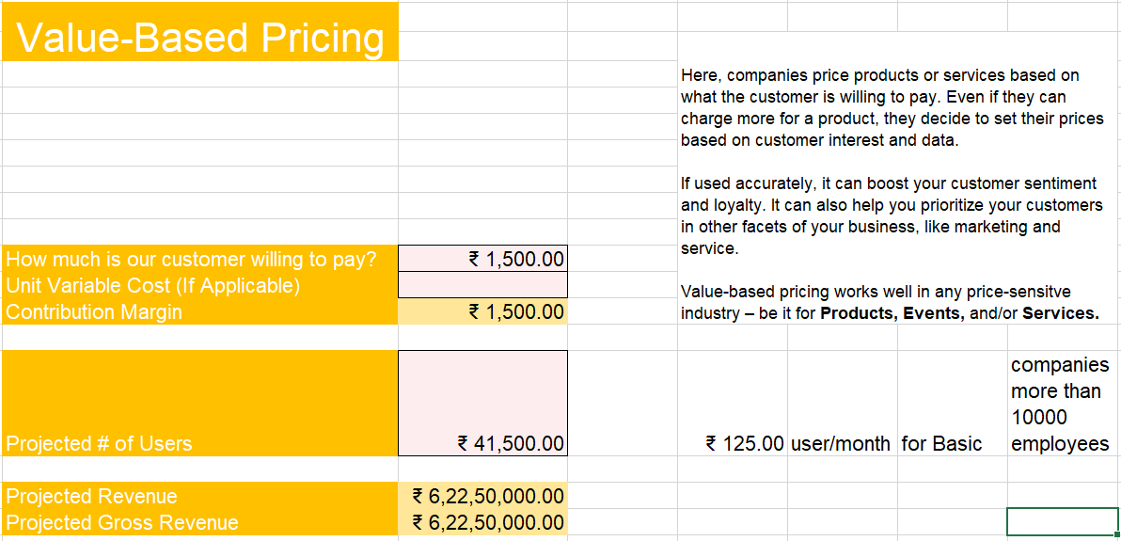
Pricing Basic
Notes:
Pricing my proposals
1. Free License for POC period - 90 Days ( Advanced) - All Values will be in Freemium
2. Pay As you Go
3. Fixed Runrate for 1 year, 2 Year & 3 Year.
Clauses
1.Feature adoption roll out will be CI/CD mode
2. Fixed runrate can not be converted to pay as you go once they are in fixed run rate
3. Pay As you go can be converted to fixed run rate any time
Features
Action Item Tracking
Appointment Scheduling
Curriculum Management
Goal Management
Mentor/Coach Matching
Mentoring Program Management
Progress Tracking
24/7 Support
9-5PM Support
API Support for integration

Slide 37
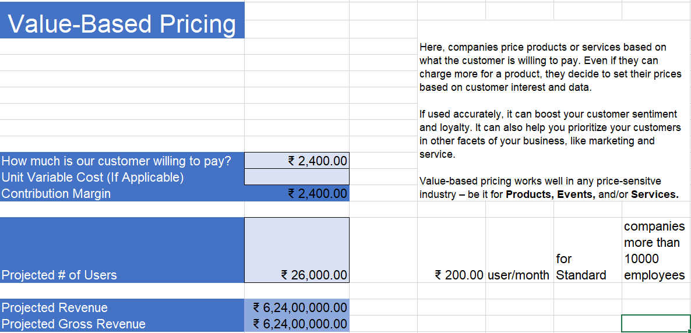
Pricing Professional
Notes:
Pricing my proposals
1. Free License for POC period - 90 Days ( Advanced) - All Values will be in Freemium
2. Pay As you Go
3. Fixed Runrate for 1 year, 2 Year & 3 Year.
Clauses
1.Feature adoption roll out will be CI/CD mode
2. Fixed runrate can not be converted to pay as you go once they are in fixed run rate
3. Pay As you go can be converted to fixed run rate any time
Features
Action Item Tracking
Appointment Scheduling
Curriculum Management
Goal Management
Mentor/Coach Matching
Mentoring Program Management
Progress Tracking
24/7 Support
9-5PM Support
API Support for integration

Slide 38
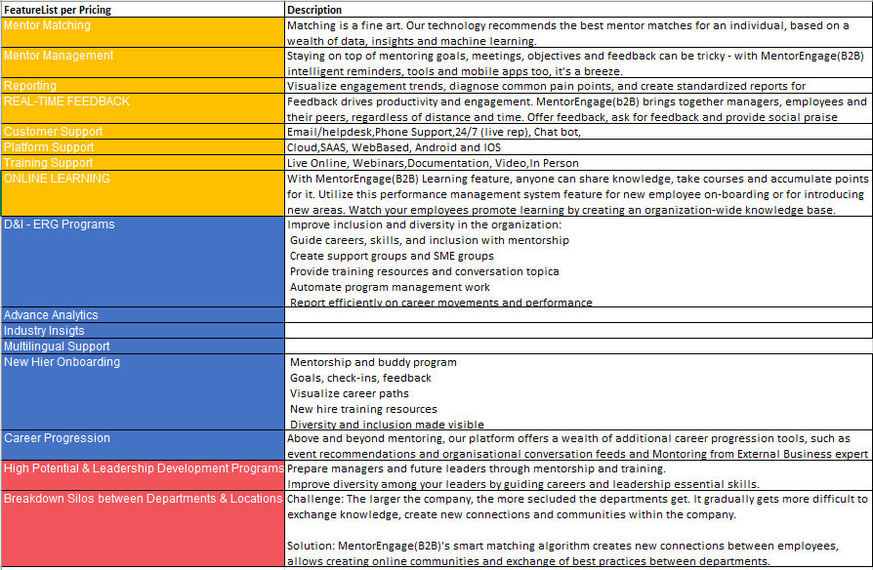
List of Features
Notes:
Mentor Matching,Mentor Management, Reporting and Analytics, Realtime Feedback
Pricing my proposals
1. Free License for POC period - 90 Days ( Advanced) - All Values will be in Freemium
2. Pay As you Go
3. Fixed Runrate for 1 year, 2 Year & 3 Year.
Clauses
1.Feature adoption roll out will be CI/CD mode
2. Fixed runrate can not be converted to pay as you go once they are in fixed run rate
3. Pay As you go can be converted to fixed run rate any time
Features
Action Item Tracking
Appointment Scheduling
Curriculum Management
Goal Management
Mentor/Coach Matching
Mentoring Program Management
Progress Tracking
24/7 Support
9-5PM Support
API Support for integration

Slide 39
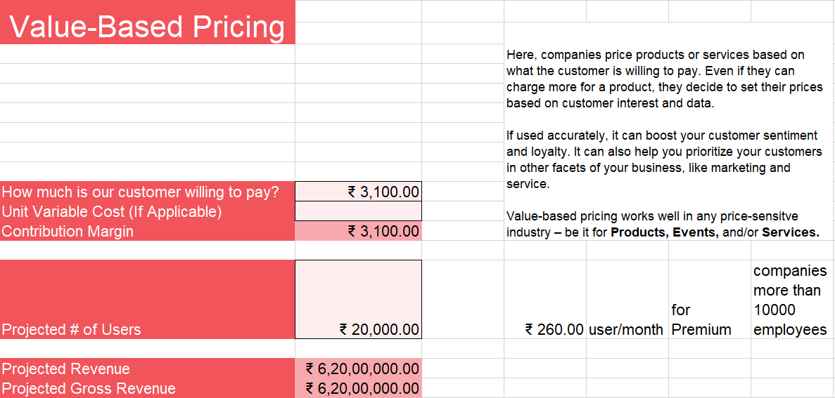
Pricing Premium
Notes:
Pricing my proposals
1. Free License for POC period - 90 Days ( Advanced) - All Values will be in Freemium
2. Pay As you Go
3. Fixed Runrate for 1 year, 2 Year & 3 Year.
Clauses
1.Feature adoption roll out will be CI/CD mode
2. Fixed runrate can not be converted to pay as you go once they are in fixed run rate
3. Pay As you go can be converted to fixed run rate any time
Features
Action Item Tracking
Appointment Scheduling
Curriculum Management
Goal Management
Mentor/Coach Matching
Mentoring Program Management
Progress Tracking
24/7 Support
9-5PM Support
API Support for integration

Slide 40
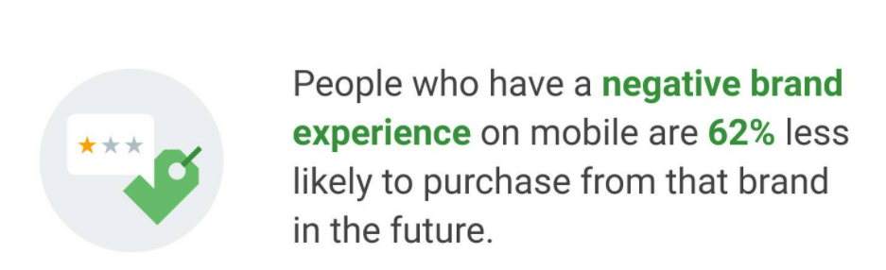
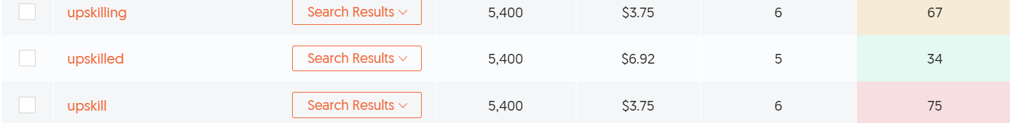
Notes:
SEO DIFFICULTY
mentoring of students
Search Results
590
$3.60
1
14
mentoring vs coaching
Search Results
2,400
$5.48
3
15
mentoring importance
Search Results
1,000
$3.11
4
20
mentoring program
Search Results
6,600
$6.06
35
30

Slide 41
Marketing Budget
Expense Head | Projection | Actual | Remaining
Product Marketing | ₹109,800.00 | ₹9,150.00
Content Creation | ₹287,544.00 | ₹23,962.50
Paid Advertising | ₹2,568,996.00 | ₹214,083.00
Public Relations | ₹136,284.00 | ₹11,357.50
Branding & Creative | ₹368,100.00 | ₹30,675.00
Events Management | ₹1,590,000.00 | ₹132,500.00
Website Redesign | ₹1,069,800.00 | ₹7,429.17
Total: | ₹6,131,724.00
Notes:
Pricing my proposals
1. Free License for POC period - 90 Days ( Advanced) - All Values will be in Freemium
2. Pay As you Go
3. Fixed Runrate for 1 year, 2 Year & 3 Year.
Clauses
1.Feature adoption roll out will be CI/CD mode
2. Fixed runrate can not be converted to pay as you go once they are in fixed run rate
3. Pay As you go can be converted to fixed run rate any time
Features
Action Item Tracking
Appointment Scheduling
Curriculum Management
Goal Management
Mentor/Coach Matching
Mentoring Program Management
Progress Tracking
24/7 Support
9-5PM Support
API Support for integration

Slide 42
A Push in the right direction...
#MentorEngageB2B

Slide 43

#MentorEngageB2B

Slide 44
Climb with Clarity...
#MentorEngageB2B

Slide 45
Climb with Clarity...
#MentorEngageB2B

